Slide 1
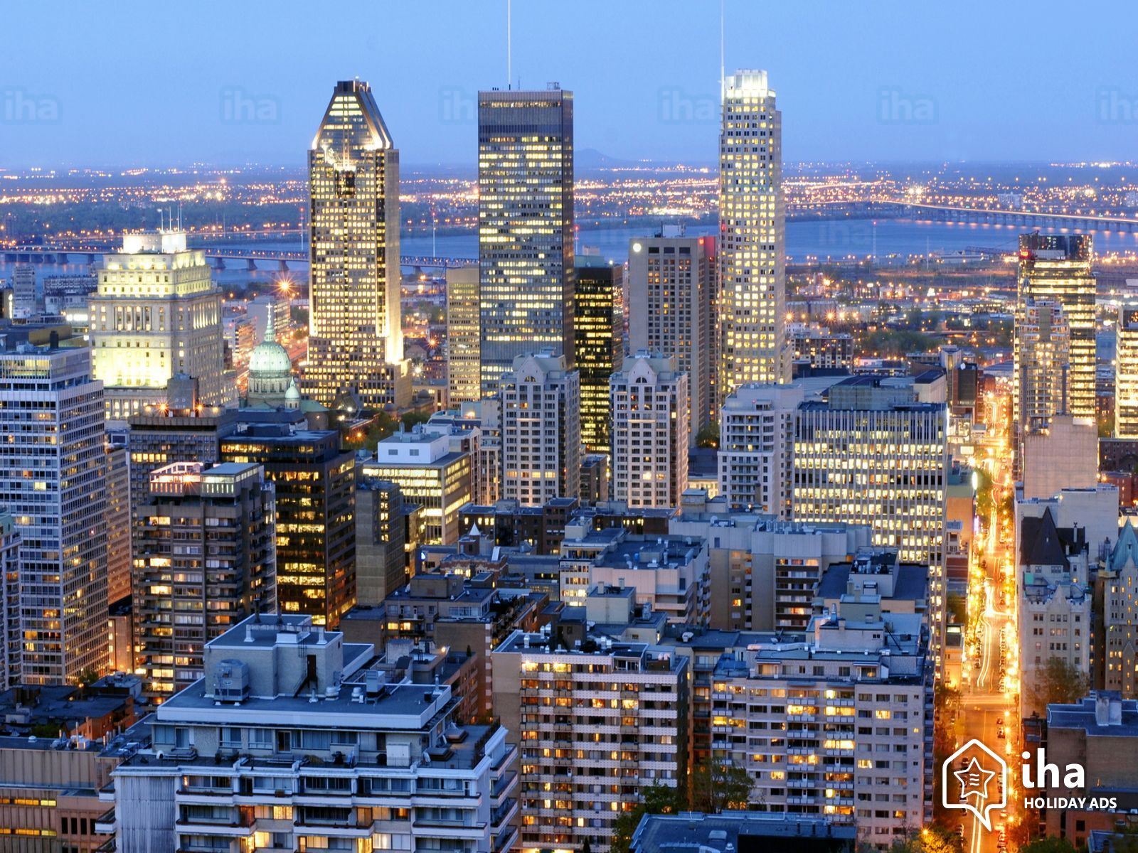
Opening Middle Eastern Restaurant in Ottawa
By
Mohamed ElKordy

Slide 2

Opening Middle Eastern Restaurant in Ottawa
Business Problem
Opening new Middle Eastern restaurant in Ottawa may be profitable for restaurant owner. Our problem is Where to open this restaurant in Ottawa?
The city grew more than 9% from 2006 to 2011, surpassing the national average of 5.9%. Ottawa is currently bracing itself for a population boom outside of the Greenbelt, which is expected to grow from 291,000 now to 432,000 by 2031.

Slide 3
Opening Middle Eastern Restaurant in Ottawa
Data Sources
» I get the neighborhood data of Ottawa from Google Search.
» I will use python geocoder library to get geographical coordinates of neighborhoods.
» I will use Foursquare API venues explore method to get the venues of given neighborhoods of Ottawa.
» I will use Foursquare API venues method to get ranks and likes of restaurants by given venue id.

Slide 4
Opening Middle Eastern Restaurant in Ottawa
Methodology
- I used GitHub repository for code versioning.
- The Ottawa data is available with the neighborhood name in google search, Wikipedia.
- Location information (latitude and longitude) of neighborhoods are taken from geocoder library.
- Transform the data of nested python dictionaries into a pandas dataframe.
- This data will used to get Venues data from Fouresquare.
- We used geopy and folium libraries to create a map of Ottawa city with neighborhoods.
- I used Clustering to cluster neighborhoods according to count of venue categories in each neighborhood. According to the below graph, I decided to separate our neighborhoods into 4 clusters.

Slide 5
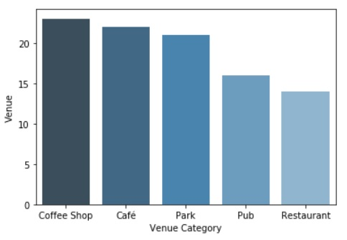
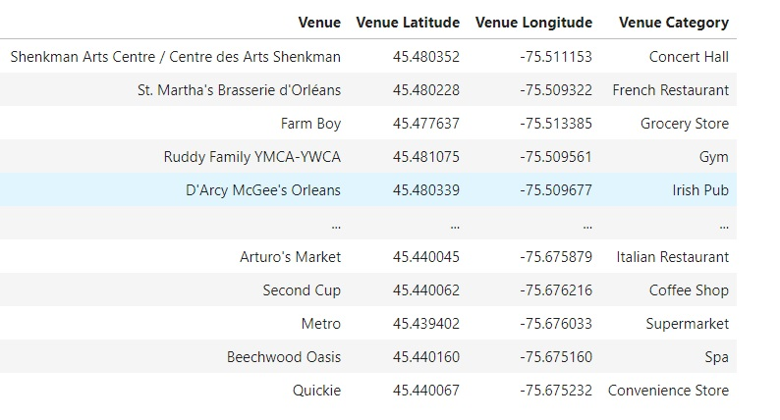
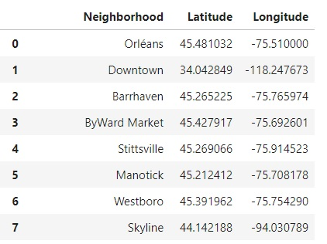
Opening Middle Eastern Restaurant in Ottawa
Methodology

Slide 6
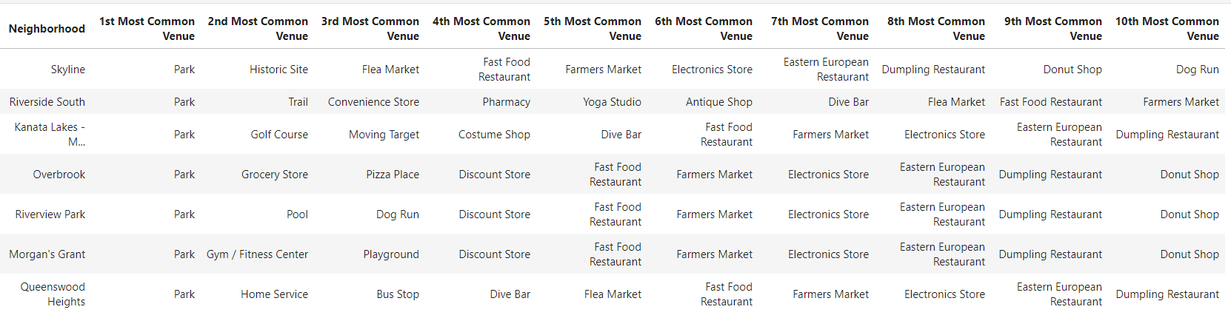
Opening Middle Eastern Restaurant in Ottawa
Methodology

Slide 7
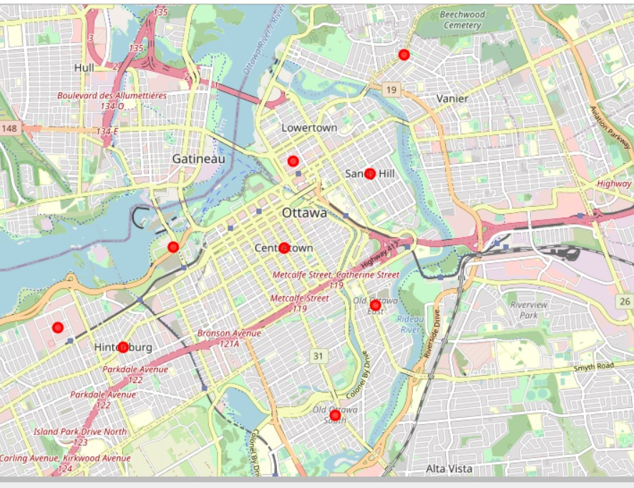
Opening Middle Eastern Restaurant in Ottawa
Methodology

Slide 8
Opening Middle Eastern Restaurant in Ottawa
Results & Discussion & Conclusion
I investigated that there is no Middle Eastern restaurant in Ottawa.
• Cluster 2 and 3 suffers from activities. Especially there is no many restaurant.
• Cluster 4 have Eastern European Restaurant and fast food Restaurant, may be these neighborhoods will not like Middle Eastern tastes. but still good to choose this cluster.
• Cluster 1 are centers full of restaurants as we saw there in the table. So we can think about these areas because it have most of the activities and restaurant and for sure this cluster have a heavy population.
I have chosen 2 locations for opening Middle Eastern Restaurant. Below are locations of neighborhoods. I hope this work will help somebody who wants to open a new Arab Eastern Restaurant in Ottawa.

Slide 9


